Slide 1

Breastfeeding Support
CS 6440
Team PANDA

Slide 2
Outline
Project Overview
Application Framework and Languages
Application Demo
Future Work

Slide 3



Project Overview
An information system application that supports breastfeeding and data exchange among mothers, doctors and Community Lactation Resources Systems.

Slide 4




Application Framework and Languages
Frontend (Javascript jQuery)
Frontend (Bootstrap)
IOS (Swift)
Restful API

Slide 5
Application Architecture
Swift
SandBox
Patient Information
FHIR
Patient Facing APP
Referral Request
Patient Information
Referral Information
Create Referral
Status
Update
jQuery
jQuery
Lactation Counseling Service APP
Physician Referral Service APP

Slide 6
Functionality Demonstration

Slide 7
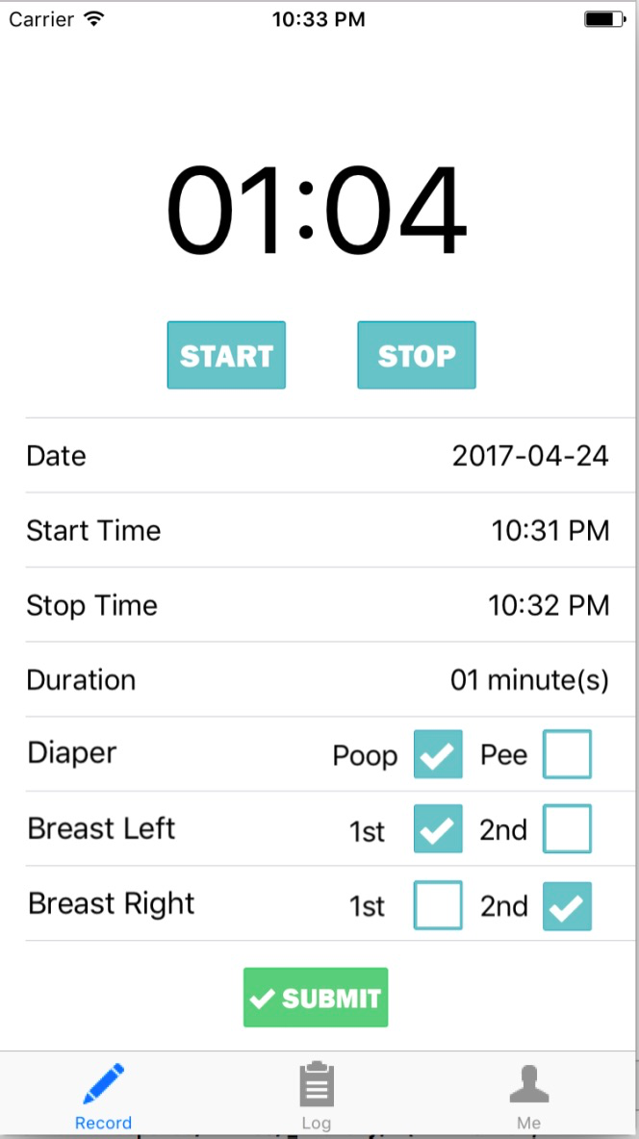
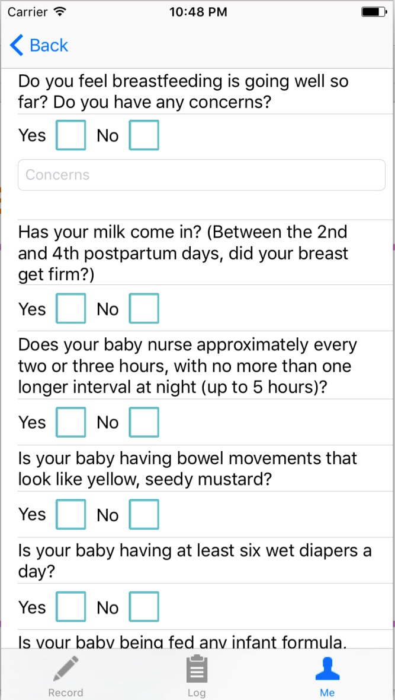
Patient Facing App
Record Breastfeeding Data
View/Track Data Log
Questionnaire Connects to FHIR
上图

Slide 8
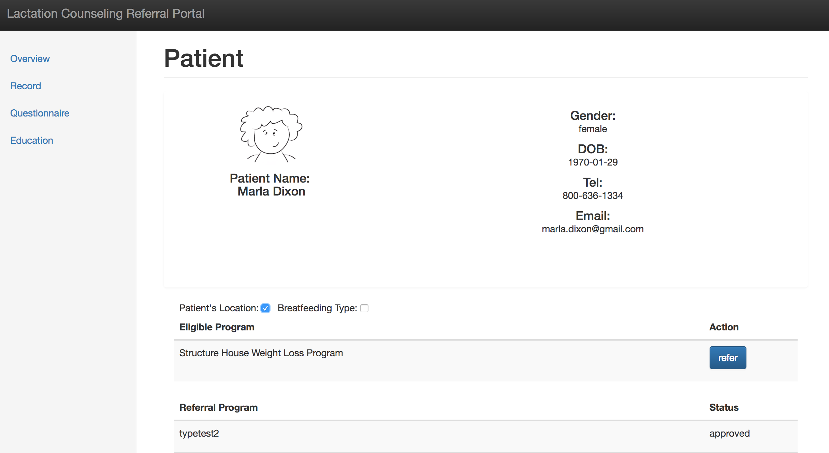
Physician Portal
Patient Information Pull
Review Questionnaire
Filter Eligible Program by
Patient Location (City)
Type of Service Needed (Breastfeeding Related)
Refer Patient to Program

Slide 9
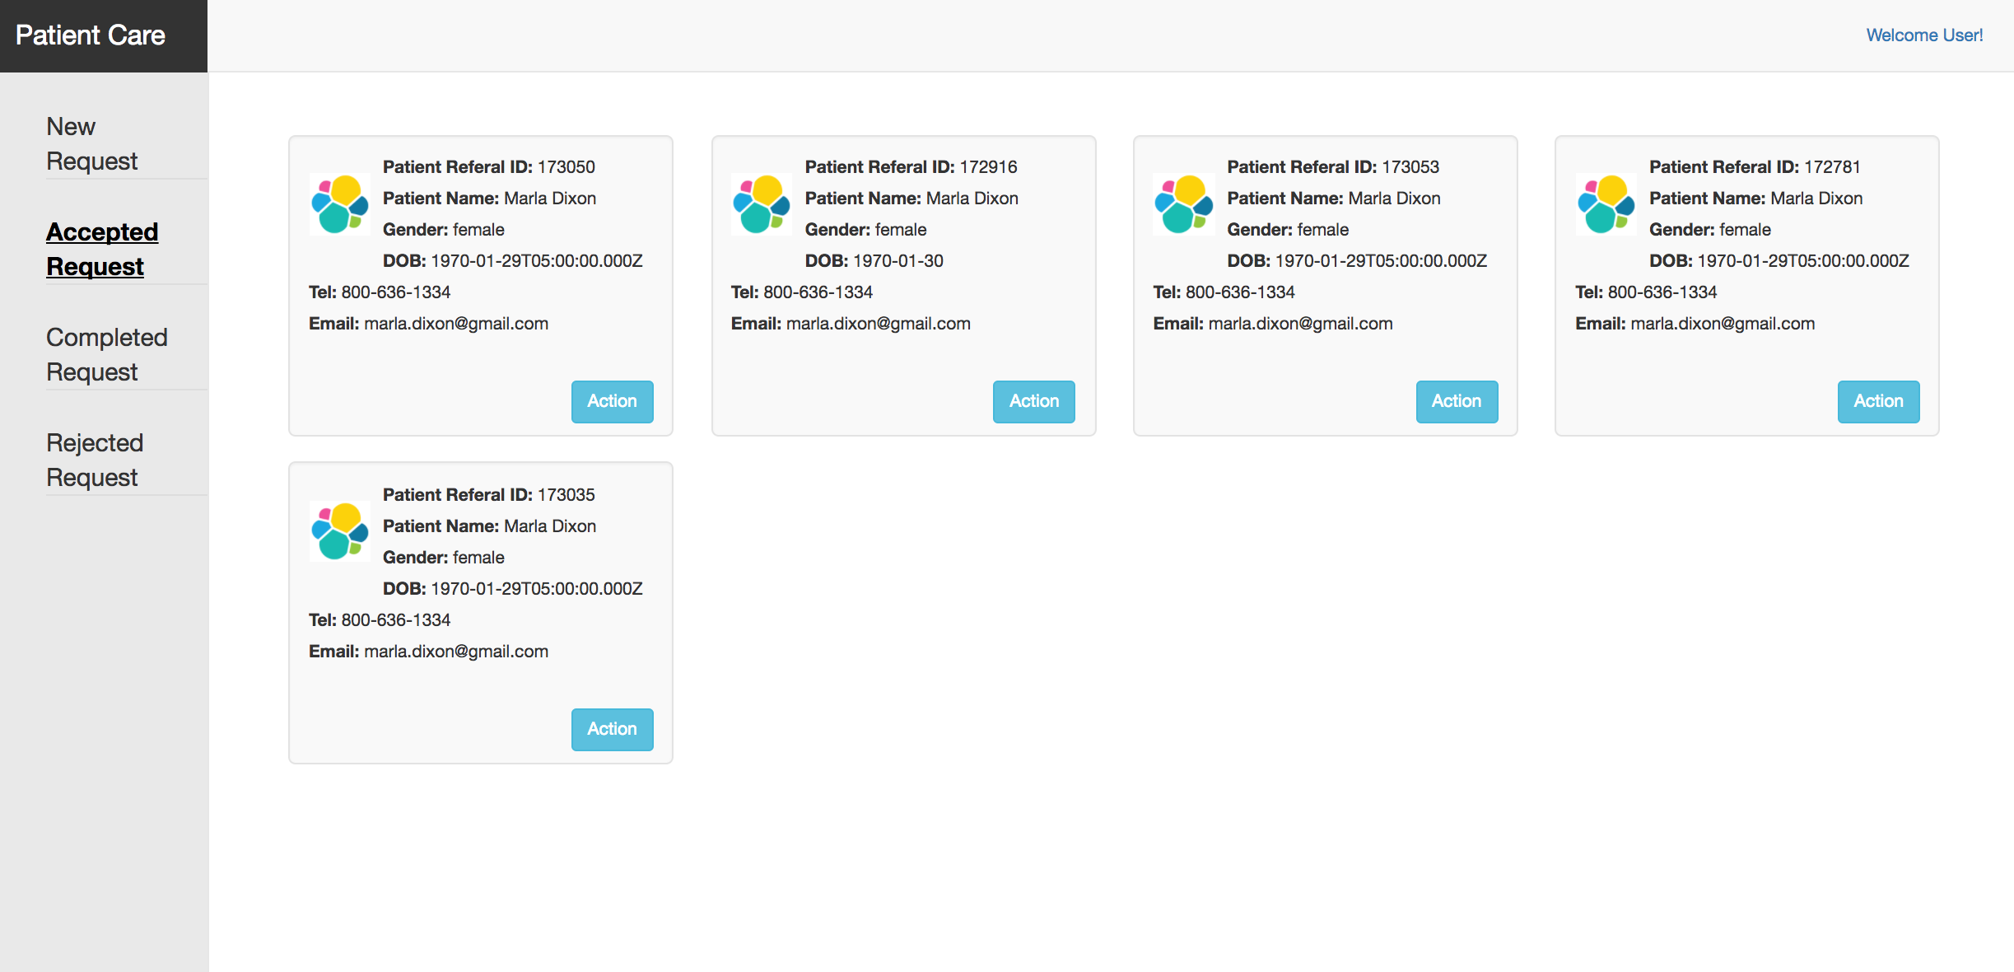
Lactation Counseling Service Portal
Patient Information Pull
Receive Patient Referral
Accept or Reject Patient Referral
Record the Visit Log and Update the FHIR Database

Slide 10

Demo Video
https://www.youtube.com/watch?v=rXSEc2uobAI

Slide 11
Future Work
Blue Button Integration (Authentication)
Build Independent User Account System (outside of FHIR)
Lactation Library Function
Warning Function in Physician Portal for Infant Weight Watch

Slide 12
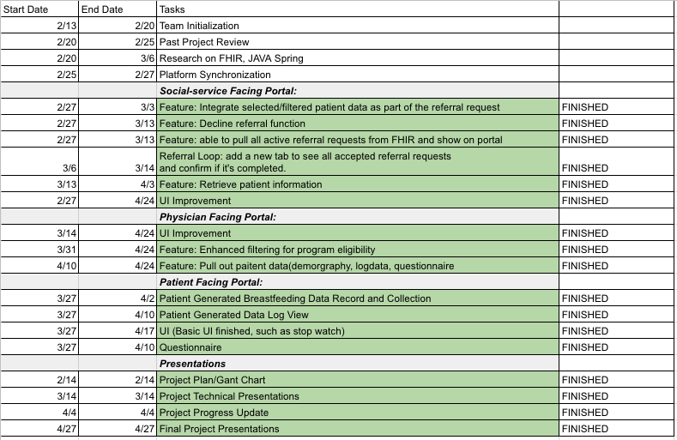
Gantt Chart

Slide 13

Questions?

